Slide 1
Week 3 Culture Characteristics of culture

Slide 2
Culture
Way of living.
the beliefs and behaviors that a social group shares.
the ideas, customs, and social behaviour of a particular people or society.
Culture is the systems of knowledge shared by a relatively large group of people.
A culture is a way of life of a group of people--the behaviors, beliefs, values, and symbols that they accept, generally without thinking about them, and that are passed along by communication and imitation from one generation to the next.

Slide 3
Culture is symbolic communication. Some of its symbols include a group's skills, knowledge, attitudes, values, and motives. The meanings of the symbols are learned and deliberately perpetuated in a society through its institutions.
“Culture is the complex whole that consists of everything we think and do and have as members of society”

Slide 4
"Culture is the acquired knowledge people use to interpret experience and generate behavior.“ - James Spradley, Anthropologist
Culture can be defined as all the ways of life including arts, beliefs and institutions of a population that are passed down from generation to generation. Culture has been called "the way of life for an entire society." As such, it includes codes of manners, dress, language, religion, rituals, art. norms of behavior, such as law and morality, and systems of belief.

Slide 5
Components/elements of culture
Values
Norms
Symbols
Language

Slide 6
Values and beliefs
Values are a culture’s standard for discerning what is good and just in society.
Values are deeply embedded and critical for transmitting and teaching a culture’s beliefs.
Values help shape a society by suggesting what is good and bad, sought or avoided.
Values are general guidelines.
Values are not static; they vary across time and between groups as people evaluate, debate, and change collective societal beliefs. Values also vary from culture to culture.
Beliefs are the tenets or convictions that people hold to be true. Individuals in a society have specific beliefs, but they also share collective values.

Slide 7
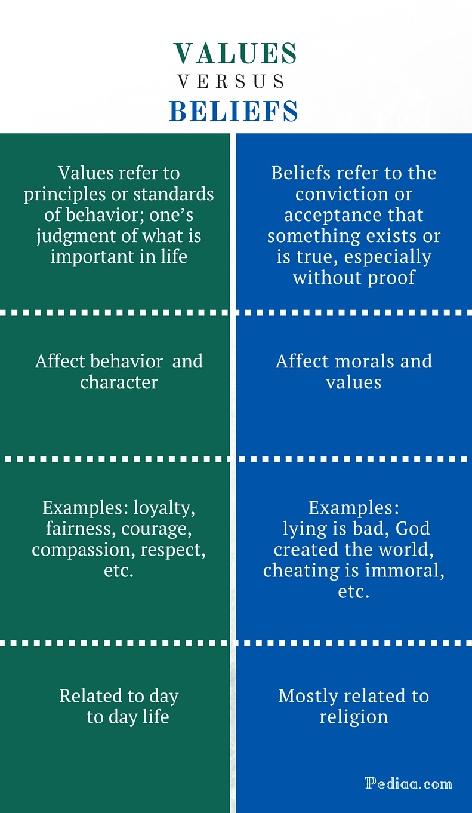

Slide 8
Norms
Norms define how to behave in accordance with what a society has defined as good, right, and important, and most members of the society adhere to them.
Norms are specific guidelines.

Slide 9
Formal norms are established, written rules. Formal norms are the most specific and clearly stated of the various types of norms, and the most strictly enforced. But even formal norms are enforced to varying degrees, reflected in cultural values.
Informal norms—casual behaviors that are generally and widely conformed to—is longer. People learn informal norms by observation, imitation, and general socialization. Some informal norms are taught directly- “Use your napkin”—while others are learned by observation, including observations of the consequences when someone else violates a norm. Informal norms dictate appropriate behaviors without the need of written rules.

Slide 10
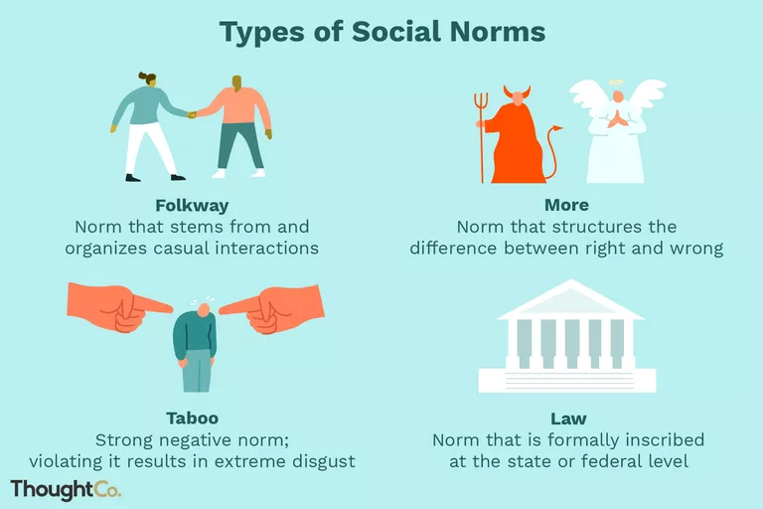

Slide 11
Folkways
Behavior pattern of society which are organized and repetitive
Rituals
These are highly scripted ceremonies or pieces of interactions that follow a specific sequence of actions.
Customs
Folkways are commonly known as Customs

Slide 12
Mores(mor-ays) are norms that embody the moral views and principles of a group. Violating them can have serious consequences. The strongest mores are legally protected with laws or other formal norms.
Folkways are norms without any moral underpinnings. Rather, folkways direct appropriate behavior in the day-to-day practices and expressions of a culture. Folkways tell us not to entered other person house without permission, don’t entered in room without knocking door, respect elder people in society etc.

Slide 13
Symbols
Symbols—such as gestures, signs, objects, signals, and words—help people understand the world. Symbols provide clues to understanding experiences. They convey recognizable meanings that are shared by societies.
Anything that carries a particular meaning recognize by people who share culture.
Symbols form the backbone of symbolic interactionism.
The world is filled with symbols. Sports uniforms, company logos, and traffic signs are symbols. In some cultures, a gold ring is a symbol of marriage. Some symbols are highly functional; stop signs, for instance, provide useful instruction.

Slide 14
Languages
Language is a symbolic system through which people communicate and through which culture is transmitted. Some languages contain a system of symbols used for written communication, while others rely only on spoken communication and nonverbal actions.
Language is constantly evolving as societies create new ideas. In this age of technology, people have adapted almost instantly to new nouns such as “e-mail” and “Internet,” and verbs such as “downloading,” “texting,” and “blogging”.

Slide 15
Types of culture
Material culture
Non-material culture
Ideal culture
Real culture

Slide 16
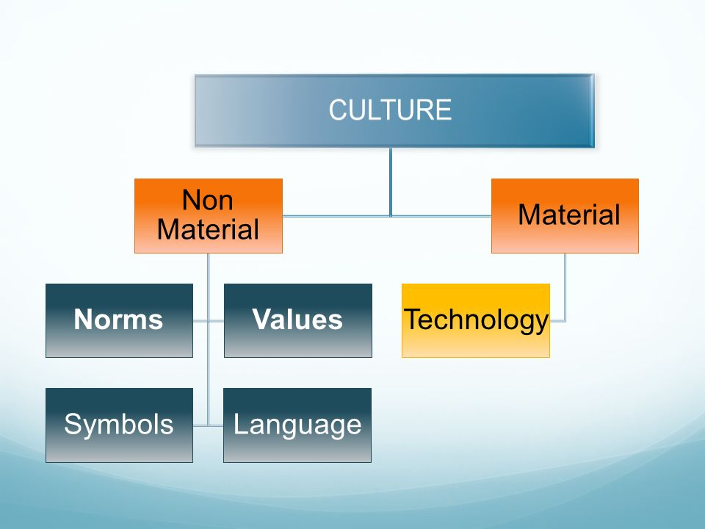

Slide 17
Material culture refers to the objects or belongings of a group of people. Metro passes and bus tokens are part of material culture, as are automobiles, stores,.
Nonmaterial culture, in contrast, consists of the ideas, attitudes, and beliefs of a society.
Material and nonmaterial aspects of culture are linked, and physical objects often symbolize cultural ideas. Clothing, hairstyles, and jewelry are part of material culture, but the appropriateness of wearing certain clothing for specific events reflects nonmaterial culture. A school building belongs to material culture, but the teaching methods and educational standards are part of education’s nonmaterial culture. These material and nonmaterial aspects of culture can vary subtly from region to region.

Slide 18
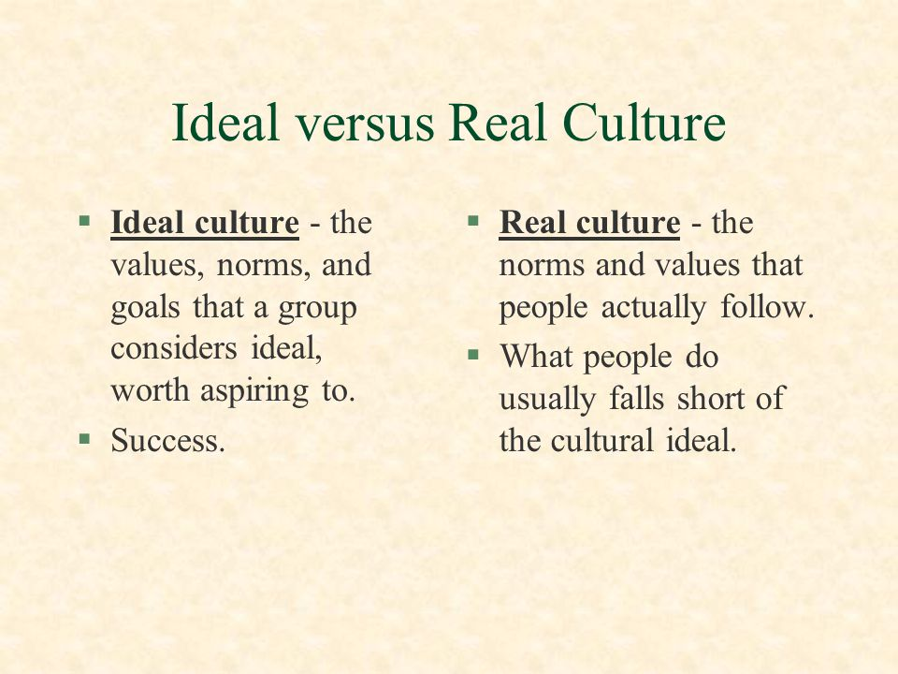

Slide 19
Characteristics of culture
Culture has five basic characteristics: It is learned, shared, based on symbols, integrated, and dynamic. All cultures share these basic features.
Culture is learned. It is not biological; we do not inherit it. Much of learning culture is unconscious. We learn culture from families, peers, institutions, and media. The process of learning culture is known as enculturation. It is also known as socialization. While all humans have basic biological needs such as food, sleep, and sex, the way we fulfill those needs varies cross-culturally.

Slide 20
Culture is Shared- culture is shared. Culture is something that a group of people shares–it is shared practices and shared understandings. Culture is shared between members of a group, meaning they all think and behave the same way because they grew up in the same culture.
Culture is Symbolic- culture is symbolic. Culture is based on symbols, and culture is spread from generation to generation through symbols. People learn their culture’s beliefs and behaviors through symbols. A symbol is something that means or stands for something else. For example, wedding rings stand for marriage, and our nation’s flag stands for our country. Language is symbolic as well–words stand for objects and ideas.

Slide 21
Not only does culture involve symbols, but symbols are used to transmit culture from generation to generation through language. Culture can be thought of as the collection of symbolic knowledge that people in a society share.
Culture is Integrated- culture is integrated. Culture is a complex system, made up of many parts that are interconnected and related to each other. Some examples of the parts of culture are education, technology, marriage, medicine, economics, family, beliefs and religion, government, and language. All aspects of a culture are related to one another and to truly understand a culture, one must learn about all of its parts, not only a few.

Slide 22
Culture is dynamic. culture is dynamic. Cultures are not static–they change over time. But why do they change? One way they change is through diffusion. Diffusion is the spreading of an idea, thing, or behavior between cultures. Cultures are not isolated–different cultures have been in contact with each other throughout history.

Slide 23
Miscellaneous Concepts of culture

Slide 24
Ethnocentrism
To evaluate another culture according to the standards of one’s own culture.
Ethnocentrism, as sociologist William Graham Sumner (1906) described the term, involves a belief or attitude that one’s own culture is better than all others. Almost everyone is a little bit ethnocentric. For example, Americans tend to say that people from England drive on the “wrong” side of the road, rather than the “other” side.

Slide 25
Xenocentrism
Xenocentrism is the opposite of ethnocentrism, and refers to the belief that another culture is superior to one’s own. (The Greek root word xeno, pronounced “ZEE-no,” means “stranger” or “foreign guest.”)
A belief that another culture is superior to one’s own.
For example, An exchange student who goes home after a semester abroad or a sociologist who returns from the field may find it difficult to associate with the values of their own culture after having experienced what they deem a more upright or nobler way of living.

Slide 26
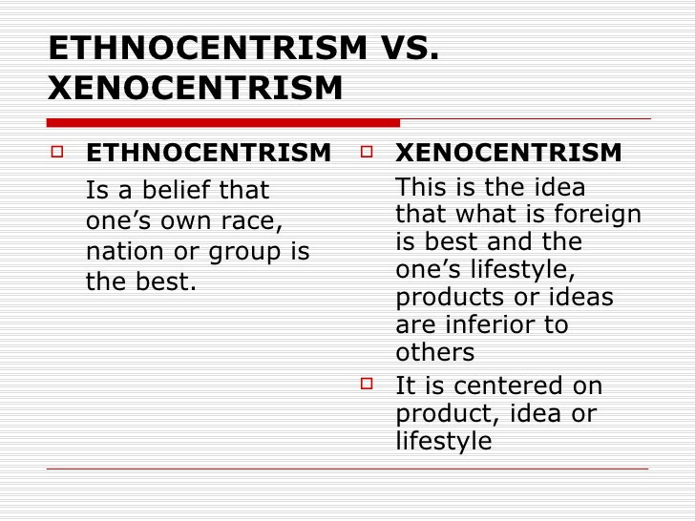
Ethnocentrism Vs Xenocentrism

Slide 27
Cultural Universal
Cultural universals are patterns or traits that are globally common to all societies.
Cultural universals often revolve around basic human survival, such as finding food, clothing, and shelter, or around shared human experiences, such as birth and death, or illness and healing.

Slide 28
Cultural Relativism
Cultural relativism is the practice of assessing a culture by its own standards rather than viewing it through the lens of one’s own culture. Practicing cultural relativism requires an open mind and a willingness to consider, and even adapt to, new values and norms.
The practice of assessing a culture by its own standards, and not in comparison to another culture

Slide 29
High Culture
Sociologists use the term high culture to describe the pattern of cultural experiences and attitudes that exist in the highest class segments of a society. People often associate high culture with intellectualism, political power, and prestige.

Slide 30
Popular culture
The term popular culture refers to the pattern of cultural experiences and attitudes that exist in mainstream society. Popular culture events might include a parade, a baseball game, or the season finale of a TV show. Rock and pop music—“pop” short for “popular”—are part of popular culture.
In modern times, popular culture is often expressed and spread via commercial media such as radio, television, movies, the music industry, publishers, and corporate-run websites. Unlike high culture, popular culture is known and accessible to most people.

Slide 31
High culture may be viewed as superior to popular culture, the labels of high culture and popular culture vary over time and place.

Slide 32
Subculture and Counterculture
A subculture is just as it sounds—a smaller cultural group within a larger culture; people of a subculture are part of the larger culture, but also share a specific identity within a smaller group.
Counterculture: groups that reject and oppose society’s widely accepted cultural patterns
Sociologists distinguish subcultures from countercultures, which are a type of subculture that rejects some of the larger culture’s norms and values.
In contrast to subcultures, which operate relatively smoothly within the larger society, countercultures might actively defy larger society by developing their own set of rules and norms to live by, sometimes even creating communities that operate outside of greater society.

Slide 33
Multiculturalism
Multiculturalism is the way in which a society deals with cultural diversity, both at the national and at the community level.
Sociologically, multiculturalism assumes that society as a whole benefits from increased diversity through the harmonious coexistence of different cultures.

Slide 34
In sociology, multiculturalism describes the manner in which a given society deals with cultural diversity. Based on the underlying assumption that members of often very different cultures can coexist peacefully, multiculturalism expresses the view that society is enriched by preserving, respecting, and even encouraging cultural diversity. In the area of political philosophy, multiculturalism refers to the ways in which societies choose to formulate and implement official policies dealing with the equitable treatment of different cultures.

Slide 35
